Slide 1
Introduction to Prism
Karl Shifflett
Program Manager, Microsoft patterns & practices

Slide 2

Agenda
Client Application Challenges
What’s In The Box?
Core Concepts
Summary

Slide 3
Client Application Challenges
The Problem:
Client Applications are Challenging
How To Make The Application Dynamic, Customizable, Extensible, Maintainable, and Testable?
The Solution:
Break Application Into Pieces
Manage Dependencies and Interactions
Re-assemble Application at Run-time
Prism:
Guidance For Building Composite Client Applications

Slide 4
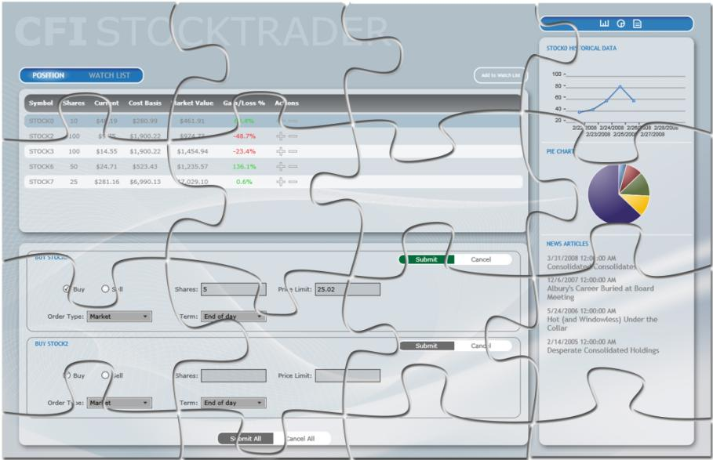
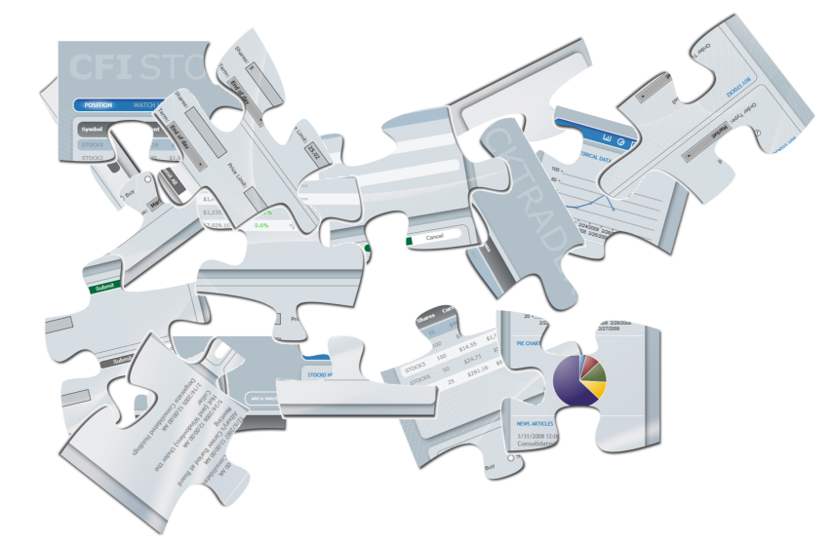
What’s a Composite Application?

Slide 5

What’s In The Box?
Prism
Prism Contains:
Library
Reference Implementations
Quick-Starts and Hand-On Labs
MSDN Documentation
Printed Book (coming soon)
Community – CodePlex
Prism Releases:
Prism 1.0 – WPF [July 2008]
Prism 2.0 – WPF & Silverlight 2.0 [Feb 2009] 2.1 – WPF & Silverlight 3.0 [Oct 2009]
Prism 4.0 – WPF & Silverlight 4.0 [Nov 2010]

Slide 6
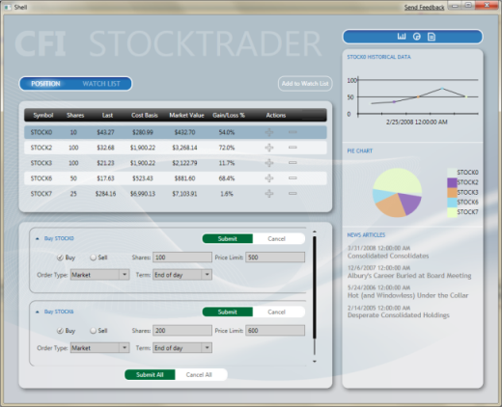
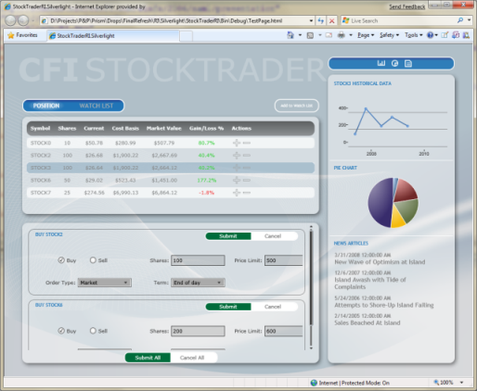
Stock Trader Reference Implementation

Slide 7
Demo
Stock Trader Reference Implementation
Walk-Through UI and Interactions

Slide 8







Prism Core Concepts
Events & Commands
Modules
Separated Presentation Patterns
UI Composition
Dependency Injection
Multi-Targeting
Navigation

Slide 9
Modules
Unit Of Application (Assembly)
Collection of Related Components
Feature, Services, Views, Data Access
Unit Of Development
Independent Development
Independent Testing
Unit Of Deployment
Up-Front
Background
On-Demand

Slide 10
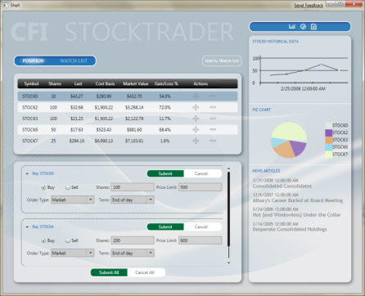
Discovering & Loading Modules
Register Modules
In code or XAML
WPF has more options
Module Loading
Up-Front
Download
Background
On-Demand
Notes:
Module Discovery:
Module Loading: From Assembly XAP, Separate XAP

Slide 11
Demo
Modules
Modules configured in code – StockTraderRIBootStrapper
Modules configured in XAML – Wpf.Demonstrations

Slide 12
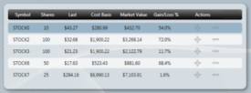
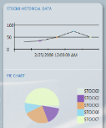
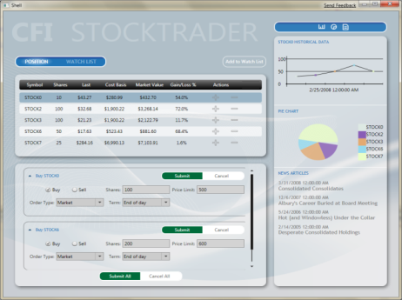
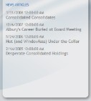
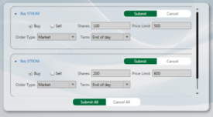
Constructing the UI
Shell – Application Host Window
Regions – Named Areas For View Placement
Views – Module UI & Presentation Logic
Region
Region
Region

Slide 13
Constructing the UI
View Injection
Uses Code to Add Views to a Region
Prism Navigation API uses View Injection
<ItemsControl RegionManager.RegionName= “DataRegion">
MyView view = …;
IRegion buySellRegion = regionManager.Regions[ “BuySellRegion" ];
buySellRegion.Add( view );
<ContentControl RegionManager.RegionName = “BuySellRegion” />
Region
Region
Region

Slide 14

Constructing the UI
View Discovery
Automatically Shows Views, Less Complex
Black Box ‘App Assembly’ Composition
Registered Views Pulled into Region
Register in code or use attribute
regionManager.RegisterViewType(
“BuySellRegion", typeof( BuySellView ) );
<ContentControl RegionManager.RegionName = “BuySellRegion” />
Region
Region
Region

Slide 15
Demo
Constructing the UI
Stock Trader PositionSummaryView
Uses Attribute View Discovery

Slide 16
Separated Presentation
Model-View-ViewModel
Model
Application Domain
View
Encapsulate UI & UI Logic
Minimal Code Behind
UI Designer Friendly
ViewModel
Presentation Logic & State
Unit Testable
UI Independent
View
ViewModel
Model

Slide 17
Demo
Separated Presentation
ArticleView, ArticleViewModel

Slide 18
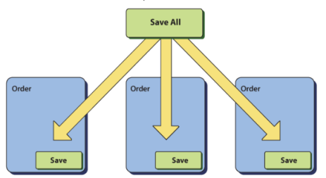
Commands and Events
Delegate Commands
Delegate Based Commanding Pattern
Composite Commands
Multiple Handler Command Routing
Event Aggregator
Loosely Coupled Pub/Sub Events
Event Aggregator
Publish
Event
Subscribe
Module A
Module B
Order Presenter
Customer Presenter

Slide 19
Demo
Commands and Events
ArticleViewModel
TickerSymbolSelectedEvent
ShowArticleListCommand

Slide 20
Navigation
State-Based
VisualStateManager State Changes
View-Based
Uses the Rich Prism Navigation API
Uri Used to Navigation Content to a Region
Lifetime Control
Silverlight Frame Navigation Support
http:/blogs.msdn.com/b/kashiffl/

Slide 21
Demo
Navigation
Codeless Navigation Initiation
ShellView – Uri Mapper
InventoryView

Slide 22
Summary
Prism: Guidance For Composite Client Applications
Library of Patterns for Modularity, Composition, Separated Presentation…
Solid but Flexible Architectural Foundation
Promotes Re-use, Unit Testing, Independent Development
Supports Design-Time & Run-Time Extensibility
Multi-Targeting
Promotes Re-use across WPF & Silverlight
Support Multi User Experience or Migration
Libraray Code, Reference Implementations, Quick-Starts, Hands-On Labs, Book (coming soon), and Documentation Available on MSDN & CodePlex
What’s Next?
Send us feedback & ideas for Prism refresh for Silverlight vNext

Slide 23
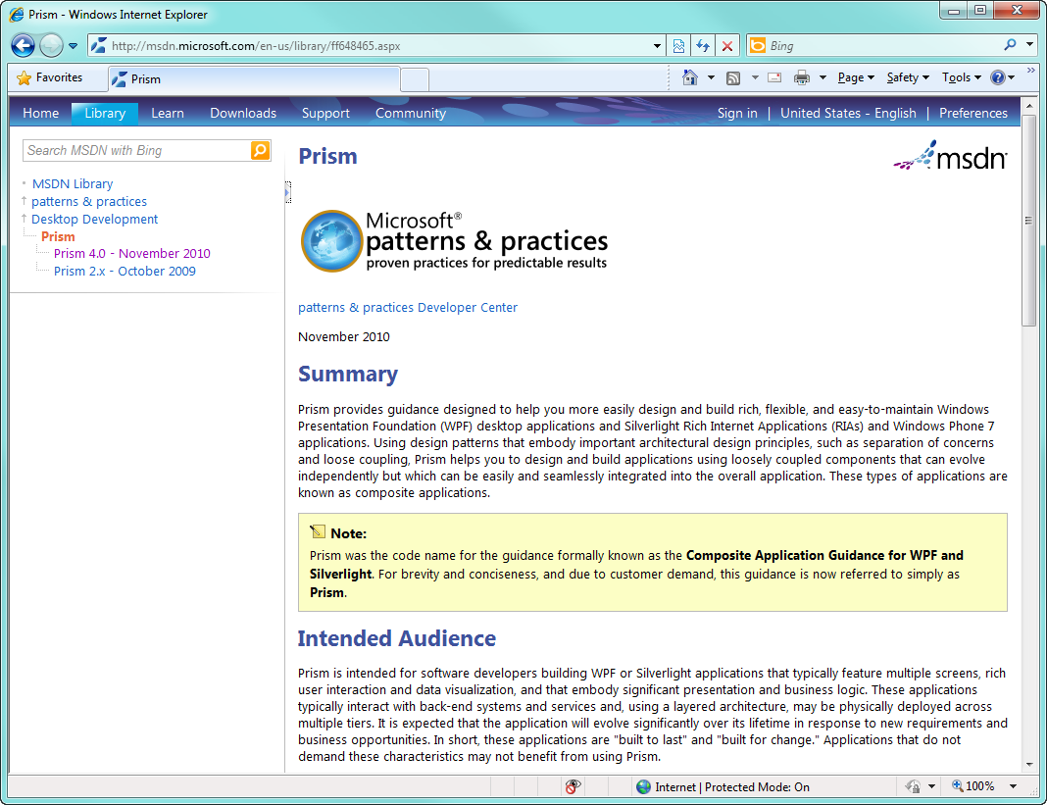
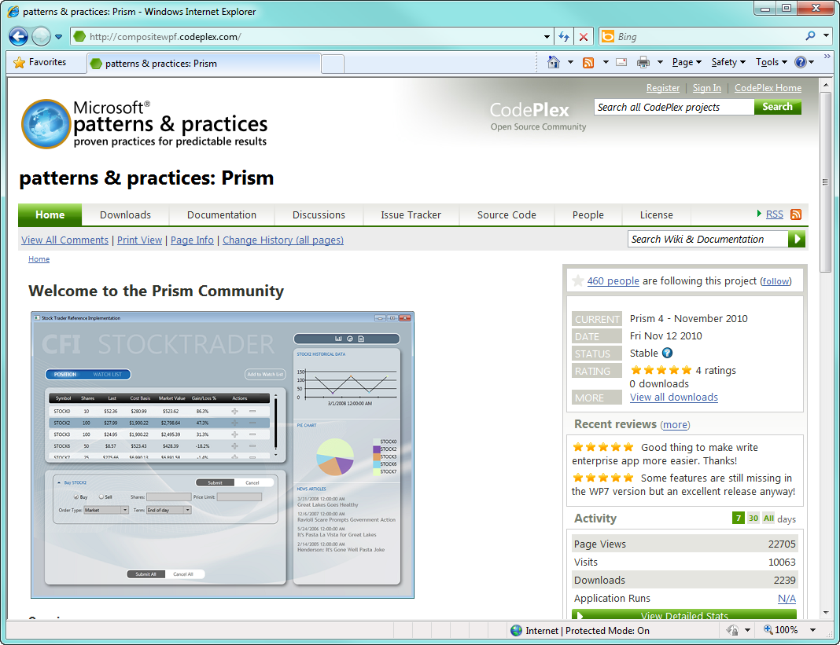
Where Can You Find It?
www.microsoft.com/prism
www.codeplex.com/prism

Slide 24
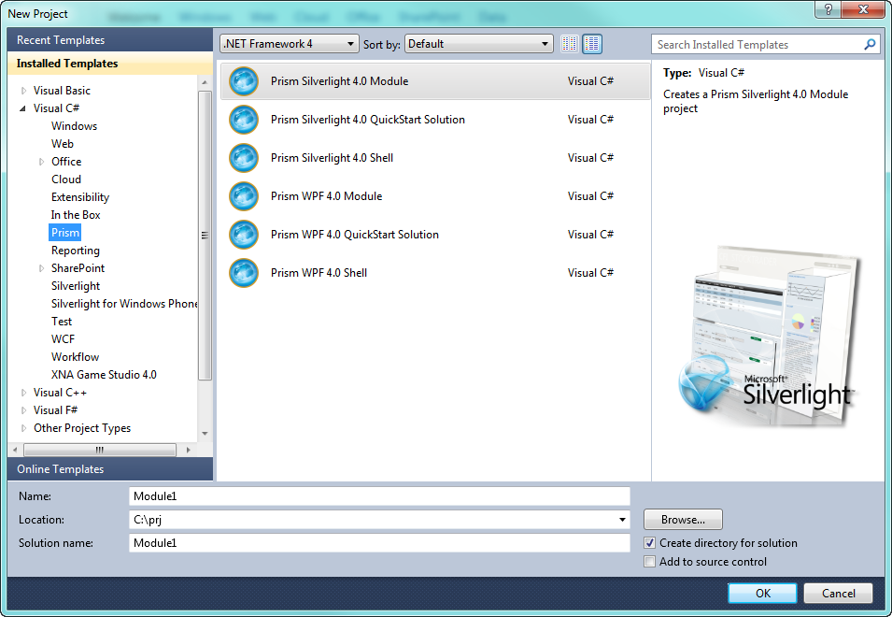
Prism Template Pack
Available From : http://blogs.msdn.com/dphill

Slide 25
Contact
Twitter: @kdawg02
Blogs
http://karlshifflett.wordpress.com/
http://blogs.msdn.com/b/kashiffl/
http://blogs.msdn.com/b/wpfsldesigner/
Links
http://compositewpf.codeplex.com/
http://msdn.microsoft.com/en-us/practices/default.aspx

Slide 26


